Slide 1
uThread Security Upgrades
Camden J. Voigt & CJ Konopka

Slide 2
Memory Leaks

Slide 3
Memory Leaks - What are they?
“A memory lead is a type of resource leak in which that occurs when a computer program incorrectly manages memory allocation in such a way that memory“ - Wikipedia
A memory leak is a type of resource leak in which that occurs when a computer program incorrectly manages memory allocation in such a way that memory that is no longer need is not released” - Wikipedia
Occurs when a program does not release the memory that it allocated
Would cause memory leaks in any program using uThread by filling up the process heap with thread memory.
y that i“A memory lead is a type of resource leak in which that occurs when a computer program incorrectly manages memory allocation in such a way that memory that is no longer need is not released” - Wikipedia
Occurs when a program does not release the memory that it allocated
Would cause memory leaks in any program using uThread by filling up the process heap with thread memory. s no longer need is not released” - Wikipedia
Occurs when a program does not release the memory that it allocated
Would cause memory leaks in any program using uThread by filling up the process heap with thread memory.
uThread by filling up the process heap with thread memory.

Slide 4
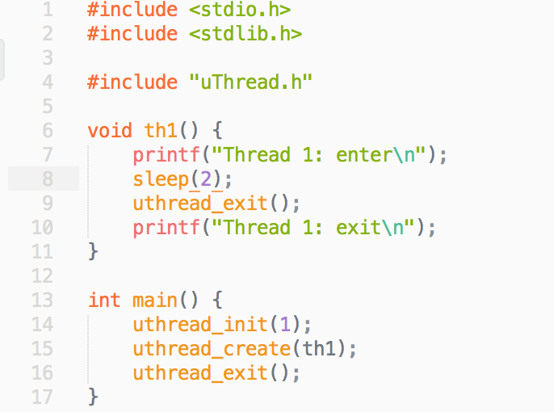
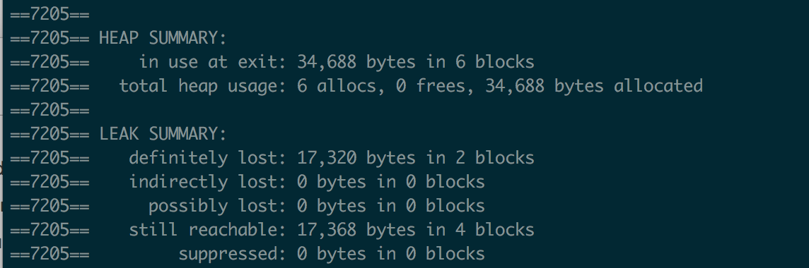
Memory Leaks in uThread
uThread leaks memory heavily because the stack for each thread is never freed after being put into the queue.
This simple example shows how many bytes are lost from just 1 thread in the queue.

Slide 5
Memory Leaks Solution
To fix the memory leaks caused by uThread we will simply free the stack space for each thread after use.
This was harder than it seems at first glance because of the way context switching works.
Implemented by saving the current queue object for each currently running thread and freeing said object when uthread_exit is called.

Slide 6
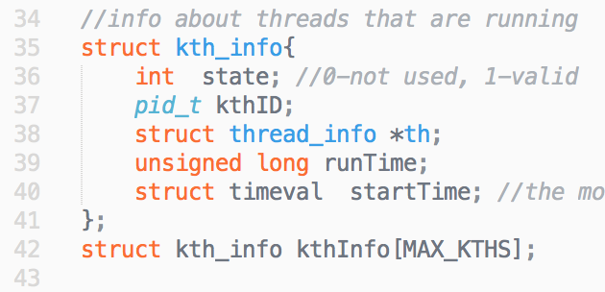
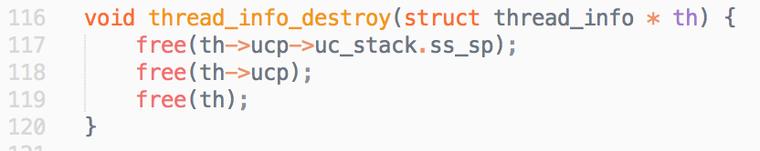
Implementation - Setup

Slide 7
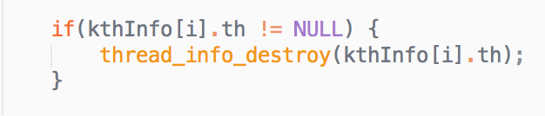
Implementation - exit

Slide 8
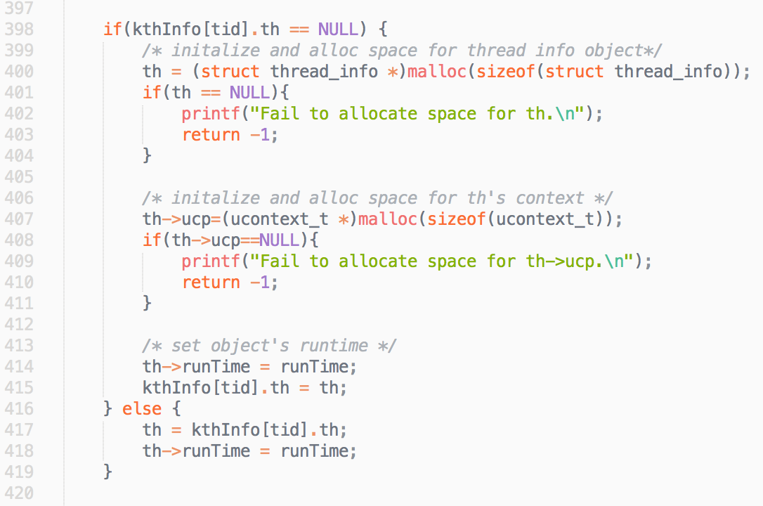
Implementation - yield

Slide 9
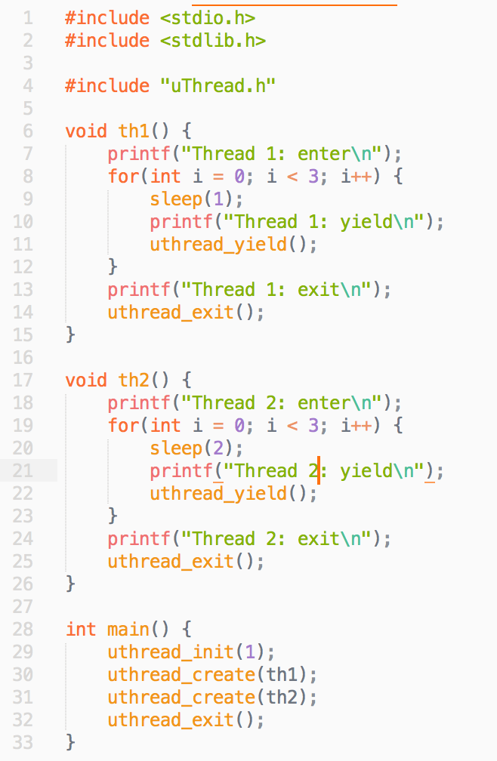
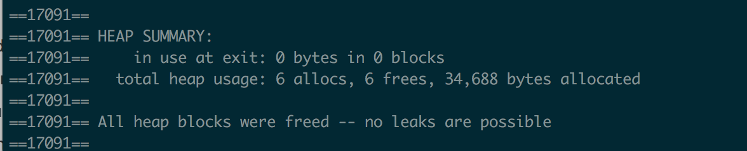
Results
No more memory leaks from the uThread library

Slide 10
Buffer Overflow

Slide 11
Buffer Overflow - What is it?
Buffer: a sequential section of memory allocated to store data
Buffer Overflow Occurs When:
program attempts to put more data in a buffer than it can hold
program attempts to put data in a memory area past a buffer
How is it used?
An attacker causes a buffer overflow and overwrites executable code with malicious code
Common example is overwriting a function pointer on the stack to point to your own function

Slide 12
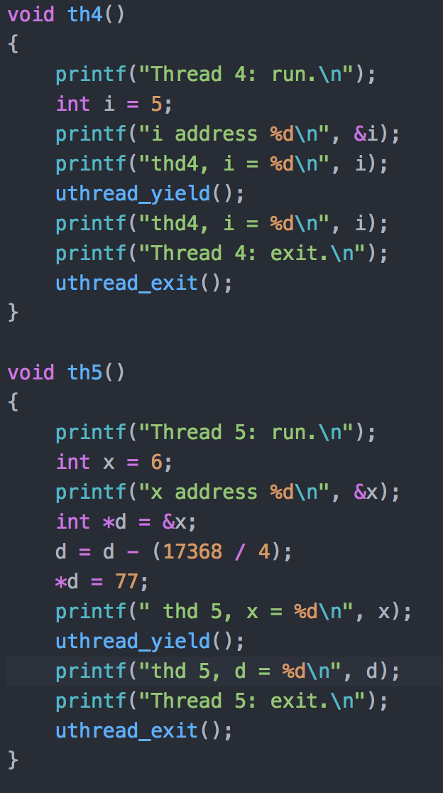
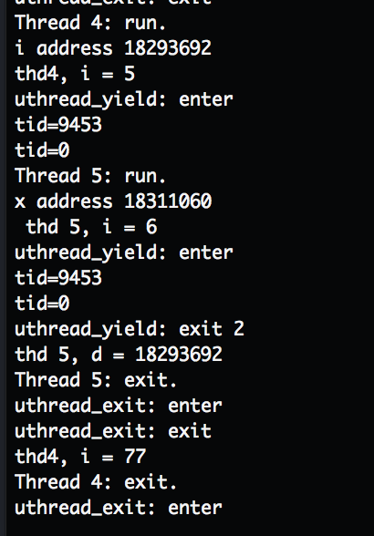
Buffer Overflow in uThread
Init buffer
uthread_init(99) when max supposed to be 10
Memory manipulation of other threads
Potential pointer override

Slide 13
How to solve
Check size of init input
Make it harder to know exactly where data is stored relative to your thread
Add a canary value before function pointers

Slide 14
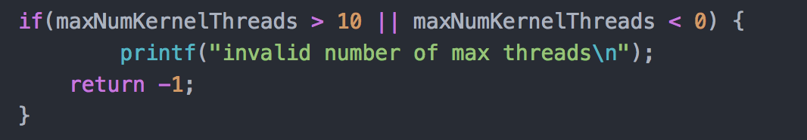

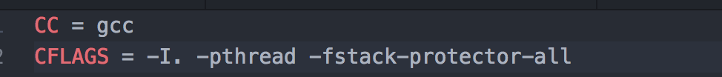
Solution implemented in uThread
Init check
Canary values

Slide 15
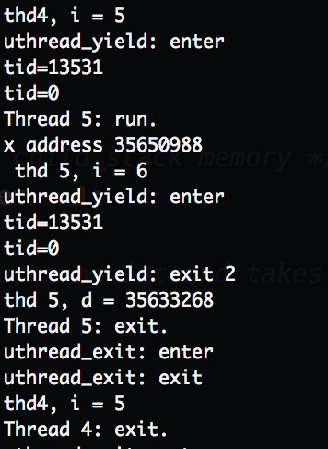
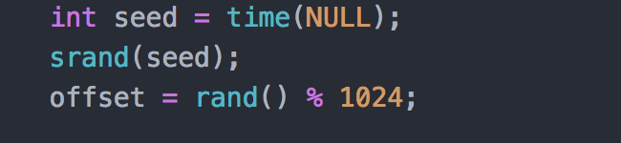
Solution implemented in uThread
Data location

Slide 16
Thread Safety

Slide 17
Thread Safety - What is it?
Thread-safe code only manipulates shared data structures in a manner that ensures that all threads behave properly and fulfil Thread-safe code only manipulates shared data structures in a manner that ensures that all threads behave properly and fulfil their design specifications without unintended interaction.
Thread safety means that threads protect their data variables so that they aren’t manipulated by other thread unexpectedly.
Without thread safety threads could manipulate each other's data which could lead to unexpected behavior their design specifications without unintended interaction.
Thread safety means that threads protect their data variables so that they aren’t manipulated by other thread unexpectedly.
Without thread safety threads could manipulate each other's data which could lead to unexpected behavior

Slide 18
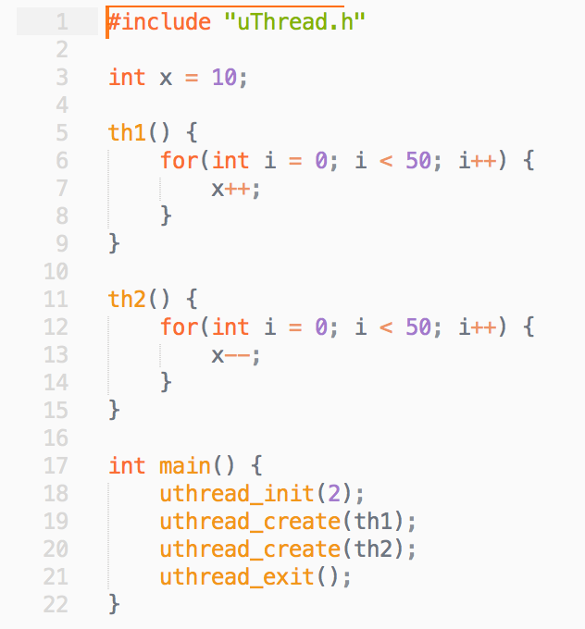
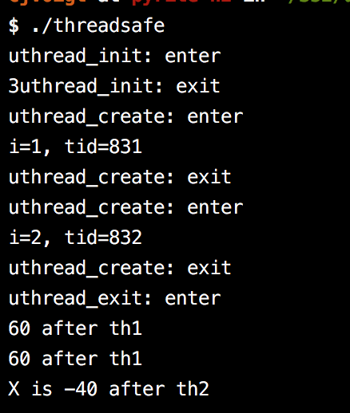
Thread Safety in uThread
uThread did not provide any thread safety guarantee
Code in different threads could manipulate each other easily as seen in this example.

Slide 19
Thread Safety - Solution
Allow users to set value that are specific to their thread
Based off of pThread implementation
Users can create keys which are associated with values that are specific to each thread
Created new functions uthread_key_create(), uthread_set_key(), uthread_get_key()

Slide 20
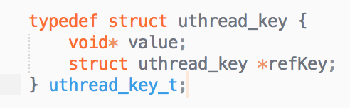
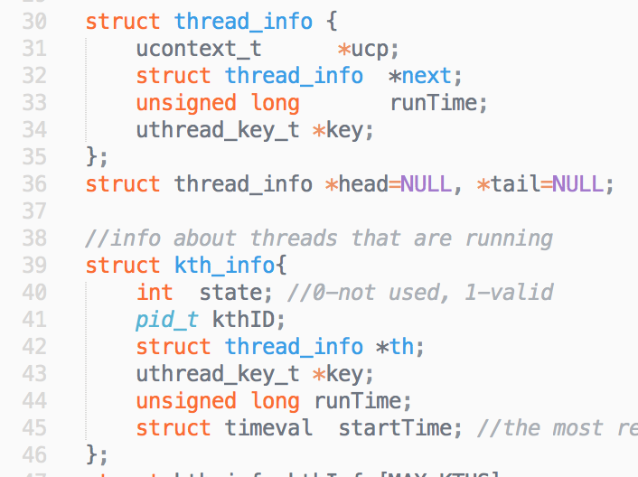
Implementation

Slide 21
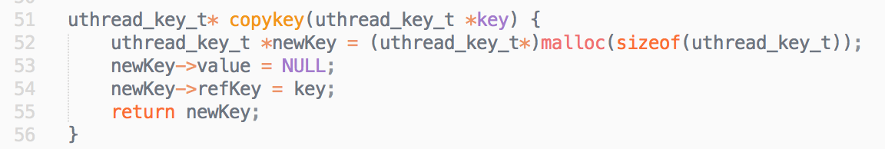
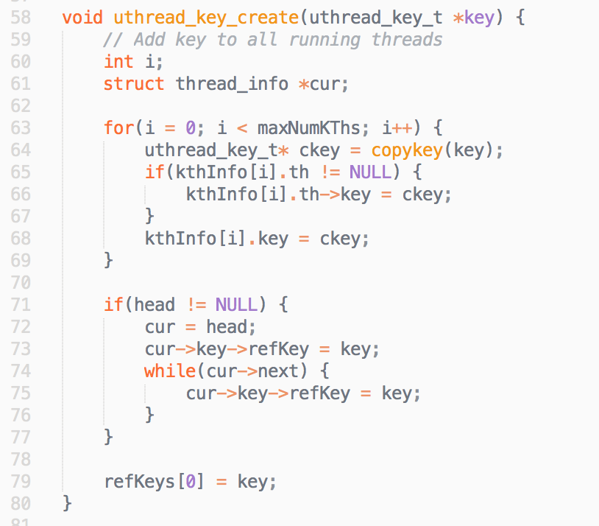
Implementation

Slide 22
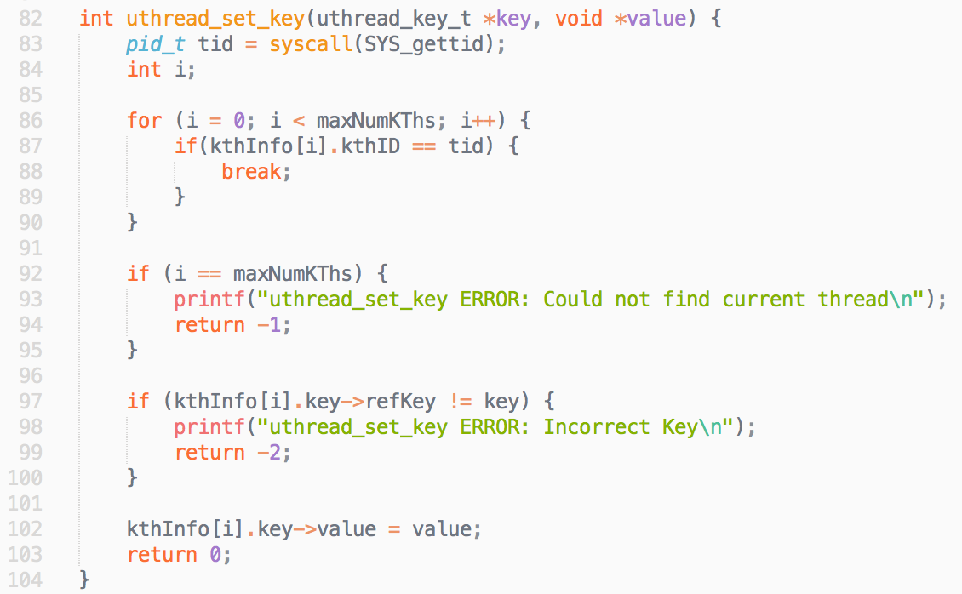
Implementation

Slide 23
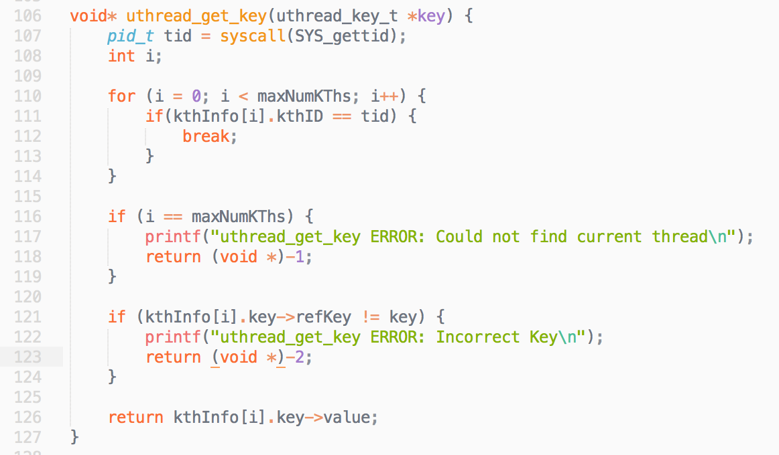
Implementation

Slide 24
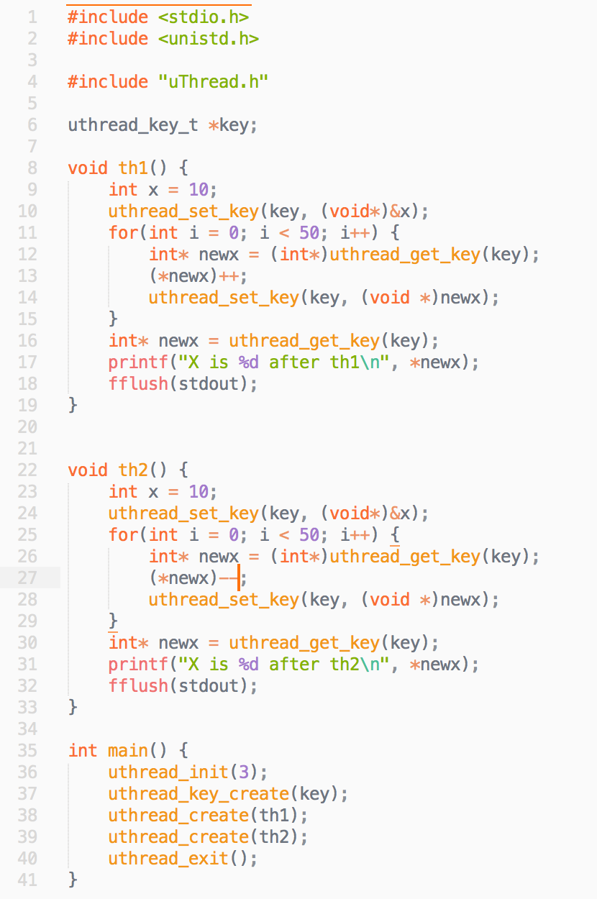
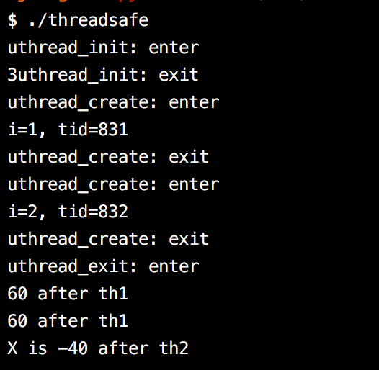
Results
The project can now be set up in a thread safe way

